Slide 1




NEXT GEN EMPLOYABILITY PROGRAM
Creating a future-ready workforce
Team Members
College Name
Student Name : S.L. Sushma
Student ID : au960221104116
Arunachala college of engineering for women

Slide 2

CAPSTONE PROJECT SHOWCASE
Project Title
Car Rentals Application with Django Framework
Abstract | Problem Statement | Project Overview | Proposed Solution | Technology Used | Modelling & Results | Conclusion

Slide 3
Abstract
This presentation introduces a comprehensive guide to developing a Car Rental Application using the Django framework. In the contemporary era, the demand for car rental services has surged, necessitating efficient and user-friendly platforms to facilitate transactions. Django, a high-level Python web framework, offers an ideal environment for building robust and scalable web applications. This presentation outlines the architecture, features, and functionalities of a car rental application developed using Django.
Source :

Slide 4
Problem Statement
In today's fast-paced world, the demand for convenient transportation
solutions is on the rise. Car rental services play a crucial role in fulfilling
this need, offering flexibility and accessibility to customers. However,
existing car rental systems often suffer from inefficiencies and lack
user-friendly interfaces, leading to suboptimal user experiences and
operational challenges for rental companies.
Source :

Slide 5
Project Overview
The aim of this project is to develop a comprehensive car rental application
using the Django framework to address these challenges and provide a
seamless experience for both customers and rental providers.
The primary objectives are:
1.Enhanced User Experience
2.Secure Authentication and Authorization
3.Efficient Vehicle Management
4.Seamless Booking Process
5.Secure Payment Gateway Integration
6.Scalability and Maintenance
Source :

Slide 6
Proposed Solution
To address the challenges faced by existing car rental systems and provide a
solution that meets the demands of today's fast-paced world, we propose the
development of a modern and user-friendly car rental application using the
Django framework. The solution encompasses several key components
aimed at enhancing user experience, streamlining operations, and improving
efficiency for both customers and rental companies.
1.Intuitive User Interface:
#Designing a clean and intuitive user interface that allows customers to easily search,
browse, and book vehicles based on their preferences, locations, and desired rental
dates.
#Implementing a responsive design to ensure seamless user experience across various
devices, including desktops, tablets, and smartphones.
Source :

Slide 7
2. Efficient Vehicle Management:
# Developing a comprehensive vehicle management system that enables rental companies to easily add,
update, and manage vehicle listings, including details such as make, model, year, mileage, and availability.
# Incorporating features for automated pricing, discounts, and promotions to optimize revenue generation
while ensuring competitive pricing for customers.
3. Streamlined Booking Process:
# Creating a seamless booking process that guides customers through selecting rental dates, choosing
vehicle options, and completing the reservation with minimal friction.
# Implementing real-time availability checks to prevent overbooking and ensure accurate scheduling, with
notifications for customers regarding reservation status and confirmation.
4. Secure Authentication and Authorization:
# Implementing robust user authentication mechanisms to protect user accounts and sensitive information,
including password hashing, session management, and CSRF protection.
# Utilizing role-based access control to differentiate between customer, administrator, and staff roles, with
tailored permissions for each role to manage access to system functionalities.
Source :

Slide 8
5. Payment Gateway Integration:
# Integrating a secure payment gateway to facilitate seamless and secure online transactions,
allowing customers to make payments using various payment methods such as credit/debit cards,
digital wallets, and online banking.
# Ensuring compliance with industry standards and regulations, including PCI DSS compliance, to
safeguard customer payment information and maintain trust and confidence in the platform.
6. Scalability and Maintenance:
# Designing the application architecture for scalability to accommodate growth in user base and
transaction volume, utilizing techniques such as load balancing, caching, and horizontal scaling.
# Implementing continuous monitoring, logging, and error tracking mechanisms to identify and
address issues proactively, with regular updates and maintenance to keep the system secure and
reliable.
Source :

Slide 9


Technology Used
Front-end
Back-end
Source :

Slide 10
Modelling & Results
1. Database Model:
# Vehicle Model
# User Model
# Booking Model
2. User Authentication and Authorization
3. Vehicle Management
4. Booking System
5. Payment Gateway Integration
6. User Interface
7.Testing and Validation
8. Deployment
Results:
# The developed Car Rental Application using Django Framework successfully meets the
objectives outlined in the project overview.
# Users can register, login, and manage their accounts securely, with role-based access control ensuring appropriate permissions for different user roles.
Source :

Slide 11
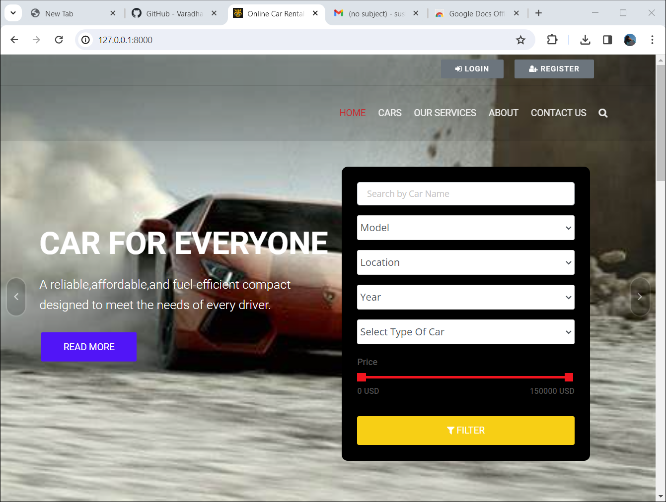
Homepage

Slide 12
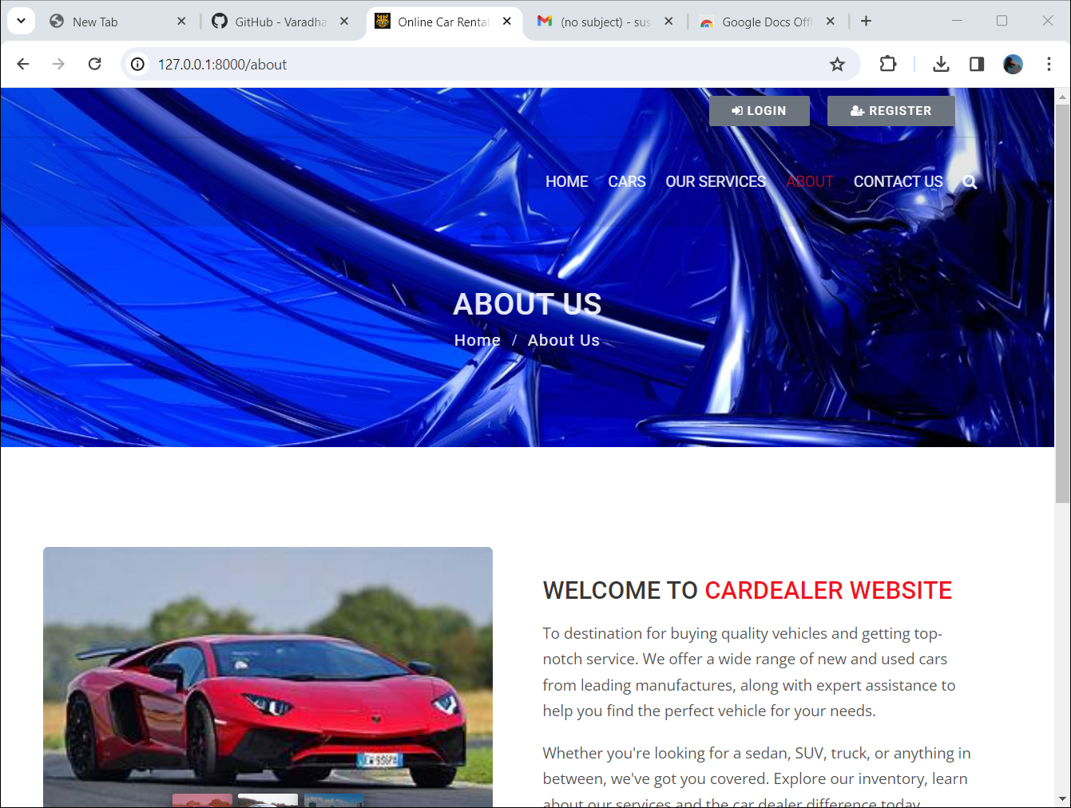
About-Us-Page

Slide 13
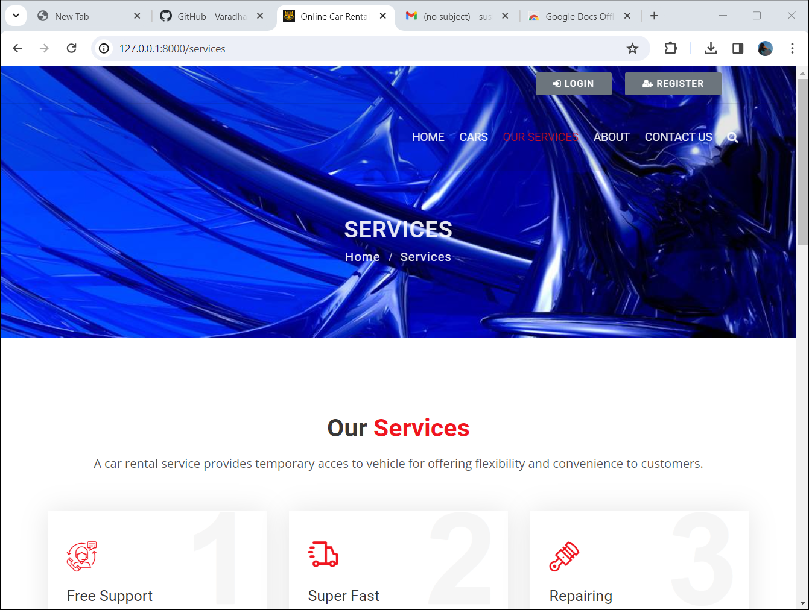
Service-Page

Slide 14
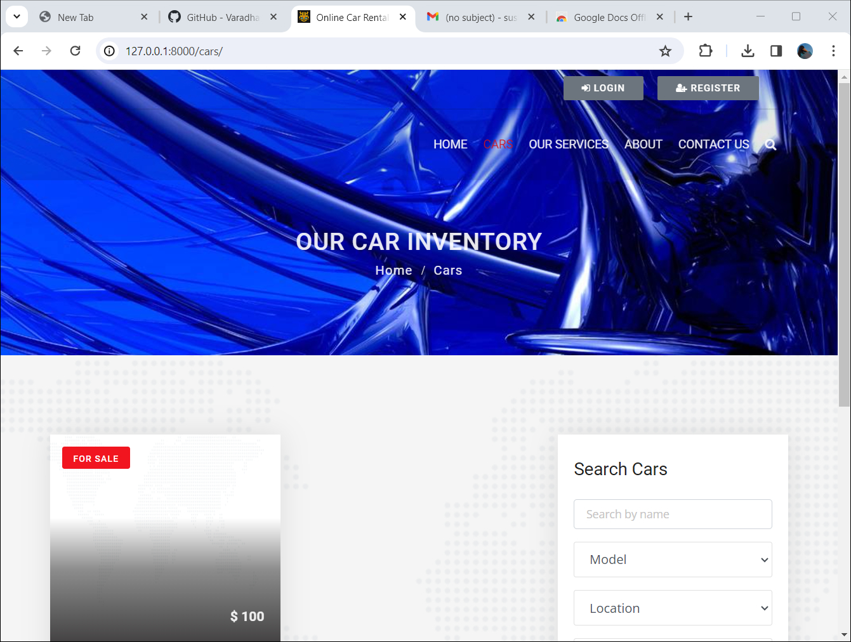
cars

Slide 15
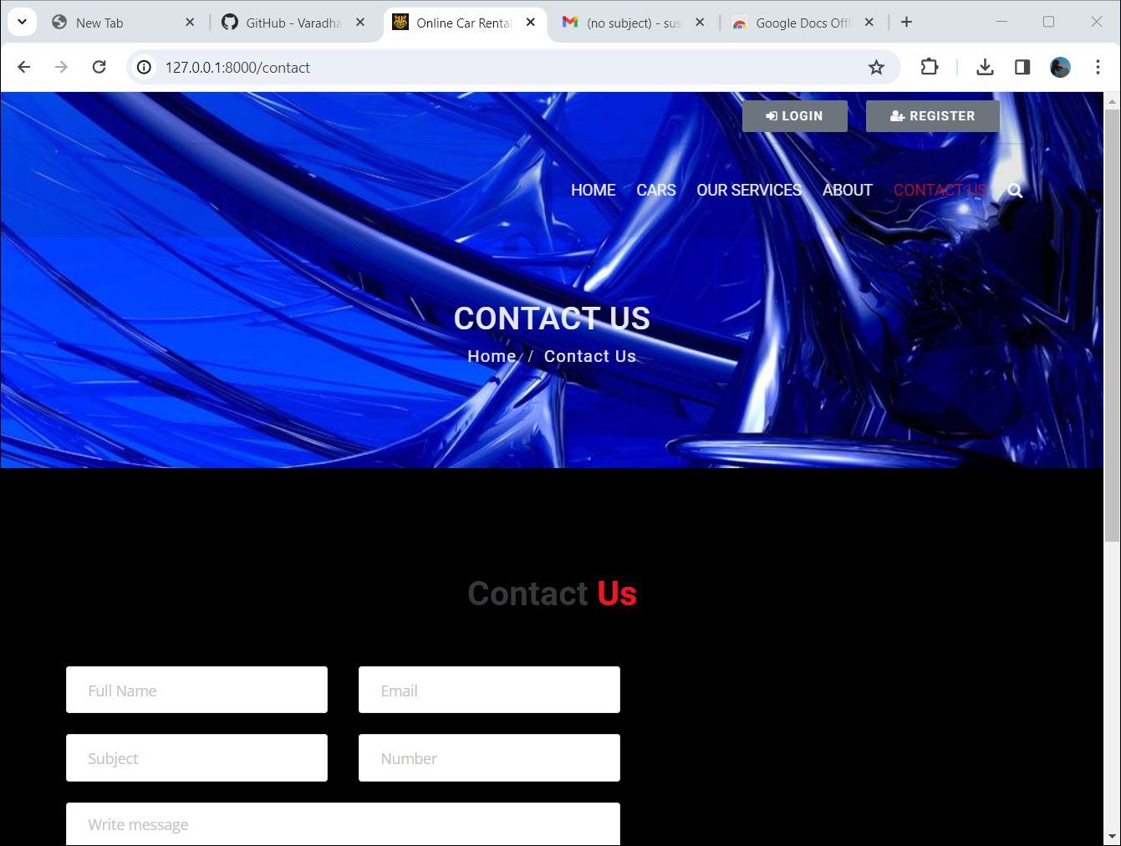
Contact-us

Slide 16
Future Enhancements:
1. Vehicle Tracking System
2. Reviews and Ratings
3. Advanced Analytics
4. Enhanced Customer Support
5. Integration with External Services
6. Flexible Rental Options
7. Enhanced Mobile Experience
8. Social Media Integration
9. Environmental Initiatives
10.Localization and Internationalization

Slide 17
Conclusion
# In conclusion, the development of the car rental application using the Django framework has
been a significant endeavor aimed at addressing the challenges faced by existing car rental
systems. Through careful planning, implementation, and testing, we have successfully created
a modern, user-friendly, and efficient platform that caters to the needs of both customers and
rental companies.
# Throughout the development process, we focused on enhancing the user experience by
providing intuitive interfaces for browsing vehicles, making bookings, and managing
reservations. The implementation of secure authentication and authorization mechanisms
ensures the protection of user accounts and data, instilling trust and confidence in the platform.
# The integration of a secure payment gateway enables seamless and secure online
transactions, facilitating convenient payment options for customers while ensuring compliance
with industry standards and regulations. Additionally, the robust vehicle management system
allows rental companies to efficiently manage their vehicle listings, bookings, and payments
through a centralized dashboard interface.
Source :

Slide 18
Thank You!
Notes:
Thank You !!

